Slide 1
Pancake Sorting
Approximation algorithms
Diego Angulo Ramirez
MIPT
2022

Slide 2

Pancake Sorting is scientifically known as Sorting by Prefix Reversal.
Pancake sorting is the mathematical problem of sorting a disordered stack of pancakes in order of size when a spatula can be inserted at any point in the stack and used to flip all pancakes above it. A pancake number is the minimum number of flips required for a given number of pancakes.

Slide 3
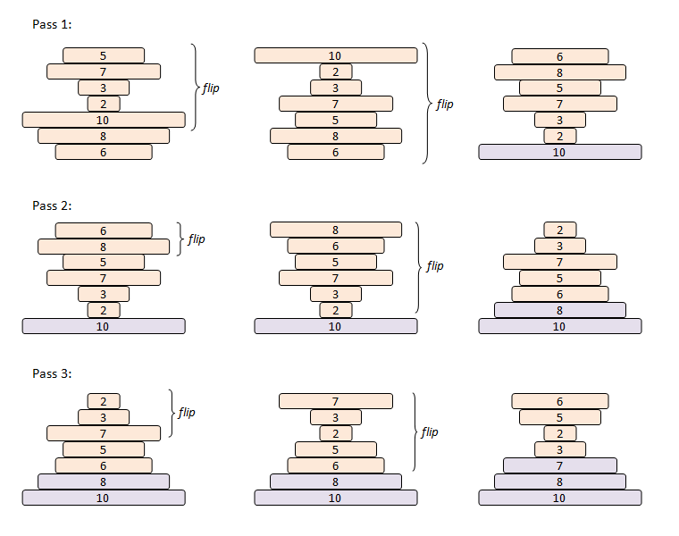

Slide 4
It has been proved that for any stack of N pancakes, the minimum number of flips required to sort it lies between 1.0714N and 1.6364 N flips, but there is not an exact formula yet.
Pancake sort can be reduced from the NP-Hard problem 3-SAT, which implies that Pancake Sorting is also NP-Hard.

Slide 5
1st Algorithm - Exhaustive search
BFS
To work with this algorithm, we will start from the sorted pancake pile, and calculate a minimum path to all the possible permutations of this pancake pile.
Really easy algorithm, but heavy both on memory and on time complexity.
This method will guarantee we get an optimal result, the only problem is that it has a big time complexity, O(N!) and a space complexity of O(N*N!).
We will use this algorithm just to measure the successfulness of the other 2 algorithms for N <= 11.

Slide 6
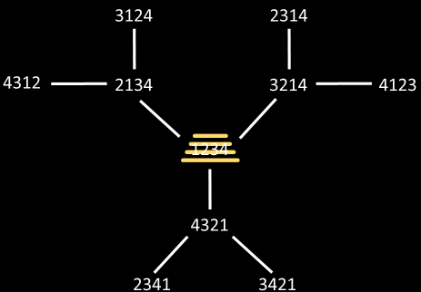
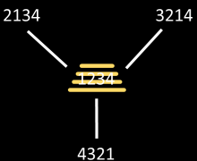
Example with N = 4

Slide 7
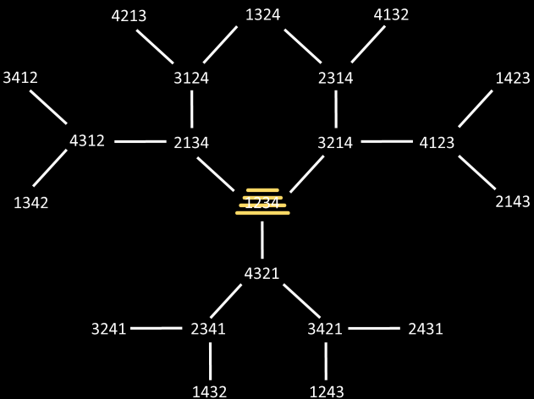

Slide 8
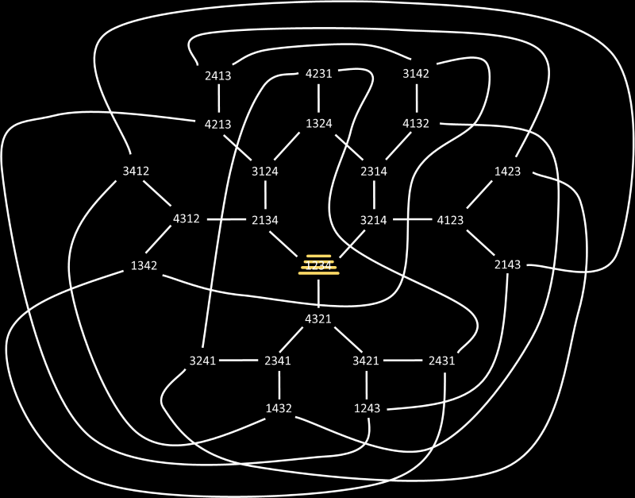

Slide 9
2nd algorithm - 3-Approximation
Intuitive flips
In this case, we will just take the biggest non-sorted pancake and take it to the top of the pile. That will take one flip.
Now we flip the pile so that the pancake on the top will be in the correct position. That will take one flip as well.
When we reach the final 2 pancakes, we only need one flip to sort them.
In general, this approach will use at most 2N - 3 flips.

Slide 10
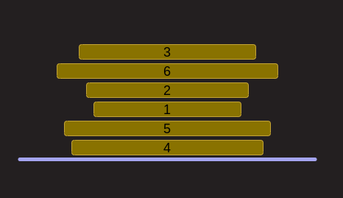
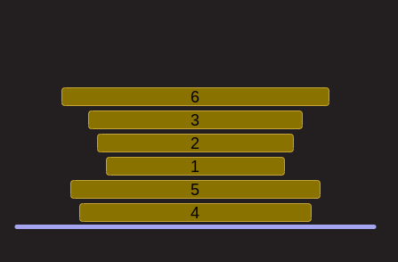
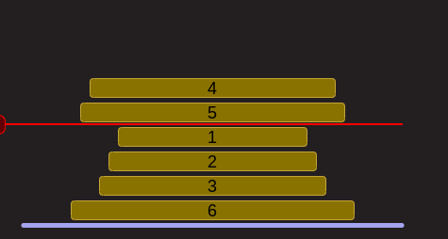
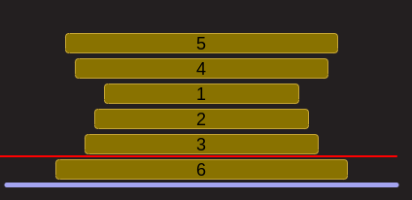

Slide 11
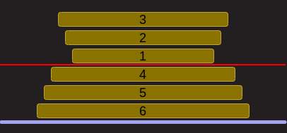
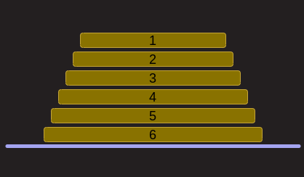

Slide 12
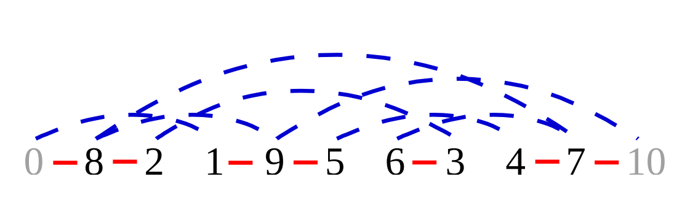
3rd algorithm - 2-Approximation
Johannes Fischer and Simon W. Ginzinger algorithm
This approximation algorithm is proved to be better approximation than the previous algorithm.
We will represent our pile of pancakes as a list, where the first value is the top of the pancake pile, and the last value on the list is the bottom of the pile.
We will also consider two imaginary pancakes with values: 0 and N+1
If two adjacent pancakes don't have adjacent values, we consider there is a red edge connecting them.
If two pancakes have adjacent values, but are not adjacent in the list, we consider there is a blue edge connecting them.

Slide 13
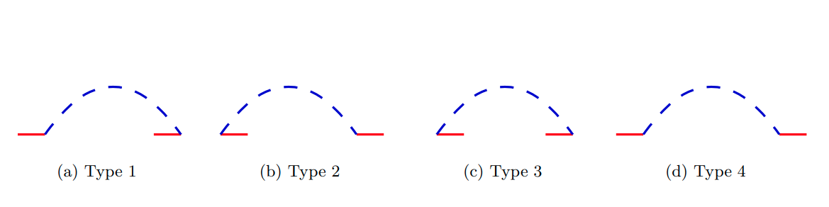
3rd algorithm - 2-Approximation
Johannes Fischer and Simon W. Ginzinger algorithm
We start by noticing that each red edge in our initial representation will take at most 2 Flips to disappear. (This is why it's called a 2-Approximation)
A representation with no red edges, is already sorted.
In order to eliminate one red edge we will consider the next 4 possible situations in our representation. For every blue edge, one of these 4 possible scenarios must be given.

Slide 14
3rd algorithm - 2-Approximation
Johannes Fischer and Simon W. Ginzinger algorithm
These situations are given between two pancakes i and j, where i < j If we have the following scenarios, we can get rid of one red edge.
Blue edge of Type 1, with i = 1
Flip (j-1)
Blue edge of Type 2, where i != 0 and j != N + 1
Flip (j)
Flip (j-i)
Blue edge of Type 3
Flip (i)
Flip (j - 1)

Slide 15
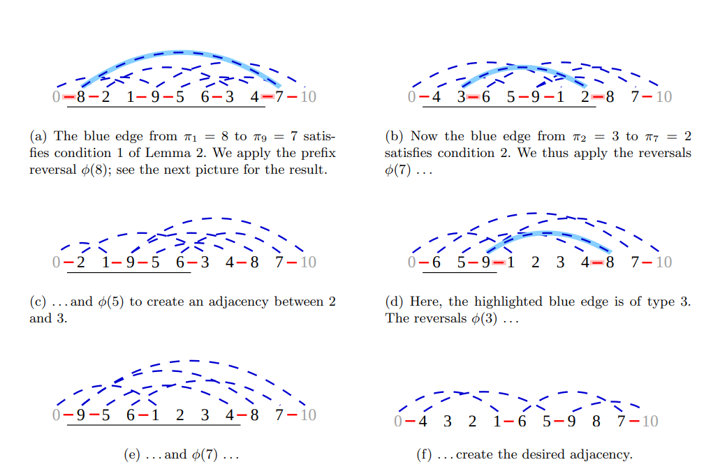

Slide 16
3rd algorithm - 2-Approximation
Johannes Fischer and Simon W. Ginzinger algorithm
Once we are finished with this process, we will have:
One blue edge of type 2, with i = 0
One blue edge of type 1, with i != 0
Other blue edges of type 4
And also, our list will have the following form: p, p1 - 1, ... , 1, p2, p2 - 1, ... , p1 + 1, ... , N, ..., pk + 1
Where k is the number of red edges remaining minus 1.
This is a simple situation to solve in exactly 2k steps.
Flip (N)
Flip (N - p1)
Flip (N)
Flip (N - (p2 - p1))
...
Flip (N)
Flip (N - (N - p_k))

Slide 17
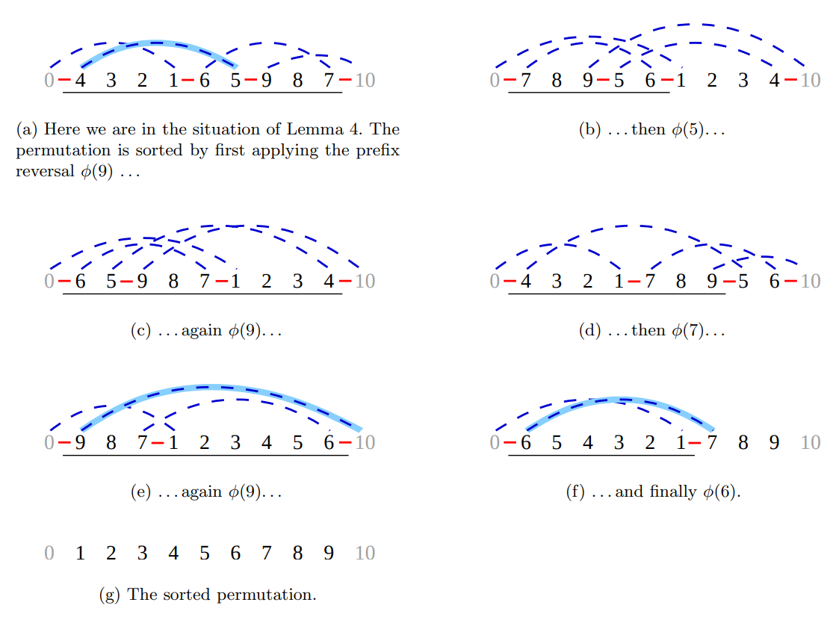

Slide 18
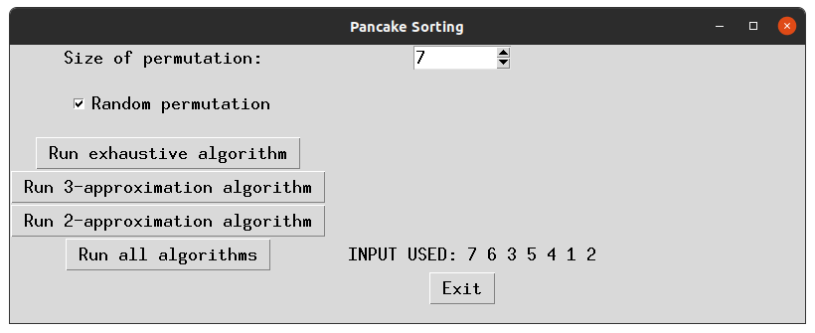
А little extra before the analysis…
GUI created so that everybody in the world can enjoy their pile of pancakes sorted!

Slide 19

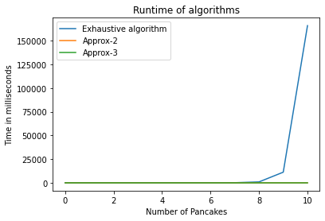
Analysis of the algorithms
Measure and comparison of runtime

Slide 20
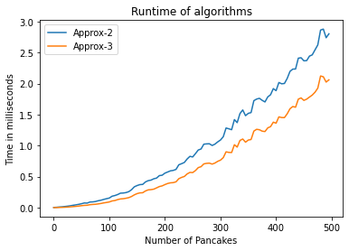
Analysis of the algorithms
Measure and comparison of runtime

Slide 21
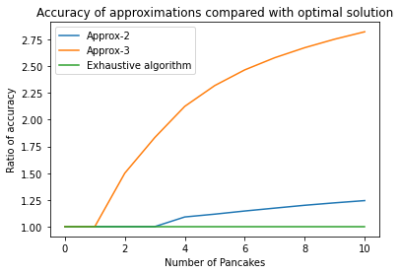
Analysis of the algorithms
Measure and comparison in efficiency

Slide 22
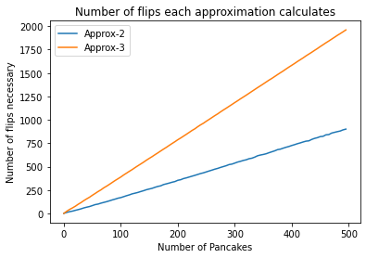
Analysis of the algorithms
Measure and comparison in efficiency

Slide 23
Results
We can see that out 2-approximation algorithm is in practice a lot better than just a 2-approximation, but more like 1.3-approximation, sadly this hasn’t been proved for the algorithm in a rigorous mathematical way.
The exhaustive algorithm actually crashes for N=11, but both approximation algorithms keep going correctly for bigger values of N.
Both curves for pancake number of 2-approximation and 3-approximation vs number of pancakes tend to be an straight line, this means we can predict their behaviour for bigger N values without even the necessity of an algorithm. This assertion is also valid for the graphic correspondent to the ratio of accuracy.

